Slide 1
Classless Inter Domain Routing (CIDR)

Slide 2
Problem CIDR Solves
Traditional IP addressing is classful
Available host IP addresses in each class make class C almost unusable, putting great pressure on class A and B:
Class A - Over 16 million host identifiers
Class B - 65,535 host identifiers
Class C - 254 host identifiers
Classful addressing: If a company has more than 254 hosts, it cannot use a class C network, but a class B network would give 65,534 hosts, which was too big! – Result waste of IP address space
Classless Inter Domain Routing (CIDR) uses Variable Length Subnet Mask (VLSM) concept, so it allows subnet masks of variable lengths
A CIDR IP address is classless
Now we can allocate IP address blocks as per the needs (and not as per the class limitations, as mentioned above)

Slide 3
CIDR Notation
Format: a.b.c.d/n
Here, n = mask or number of bits representing the network id
Example of a CIDR address: 200.10.20.40/28
This is called as the slash notation
Now network id is called as prefix and host id is called as suffix
In the above example, 28 bits represent the network id and 4 bits represent the host id, so 2⁴ - 2 = 14 hosts are possible
Binary mask will be 11111111.11111111.11111111.11110000, decimal mask will be 255.255.255.240
Network id Host id
Prefix Suffix

Slide 4
CIDR: Finding Network Id
Consider a CIDR address 200.10.20.40/28
Writing the last octet in binary: 200.10.20.00101000/28
Since the slash notation is /28, the first four bits of the last octet are a also part of the prefix – we must not touch them
So, in CIDR:
The network address will be 200.10.20.00100000/28 and in decimal it will be 200.10.20.32/28
The broadcast address will be 200.10.20.00101111/28 and in decimal it will be 200.10.20.47/28
The host range is 200.10.20.33/28 to 200.10.20.46 (14 hosts)

Slide 5
Rules for CIDR
Addresses should be contiguous
Number of addresses in a block must be power of 2
First address of any block must be evenly divisible by the size of the block

Slide 6
Example
Is a block of IP addresses 100.1.2.32/28 to 100.1.2.47/28 a valid IP address block?
All the IP addresses are contiguous.
Total number of IP addresses in the Block = 16 = 2⁴.
1st IP address: 100.1.2.00100000/28. Since Host Id will contains last 4 bits and all the least significant 4 bits are zero; the first IP address is evenly divisible by the size of the block.
All three rules are followed by this Block. Hence, it is a valid IP address block.

Slide 7
Tricky Problem
Do the following two IP addresses belong to the same physical network?
192.168.200.5/30 and 192.168.200.9/30

Slide 8
Solution
First IP address
Address: 192.168.200.5/30 11000000.10101000.11001000.00000101
Netmask: 255.255.255.252 11111111.11111111.11111111.11111100
4 addresses are possible, including network address and broadcast address
Network: 192.168.200.4/30 11000000.10101000.11001000.00000100
Host 1: 192.168.200.5 11000000.10101000.11001000.00000101
Host 2: 192.168.200.6 11000000.10101000.11001000.00000110
Broadcast: 192.168.200.7 11000000.10101000.11001000.00000111
Hosts/Net: 2

Slide 9
Solution
In other words, these ae different networks
Note that it was 000001 for the previous example, and now it is 000010
Second IP address
Address: 192.168.200.9/30 11000000.10101000.11001000.00001001
Netmask: 255.255.255.252 11111111.11111111.11111111.11111100
4 host address are possible, including network address and broadcast address
Network: 192.168.200.8/30 11000000.10101000.11001000.00001000
Host 1: 192.168.200.9 11000000.10101000.11001000.00001001
Host 2: 192.168.200.10 11000000.10101000.11001000.00001010
Broadcast: 192.168.200.11 11000000.10101000.11001000.00001011
Hosts/Net: 2

Slide 10
Conclusion
Hosts 192.168.200.5/30 and 192.168.200.9/30 have the same suffix, and yet they do not belong to the same physical network

Slide 11
CIDR, Route Aggregation and Supernetting
Supernetting is the process of summarizing a number of contiguous subnetted networks back in a single large network
This process is also known as route summarization or route aggregation
Supernetting is mainly done for optimizing the routing tables
Without supernetting, a router will share information about all the routes in its routing table with the other routers
With supernetting, it will summarize them before sharing
Route summarization reduces the size of routing updates dramatically

Slide 12
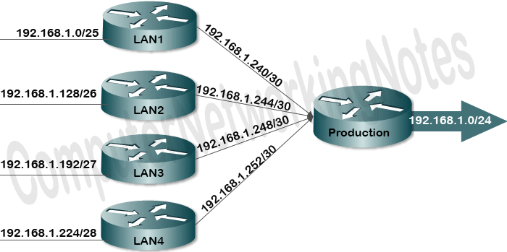
Supernetting Example – 8 Subnets Summarized Into One

Slide 13
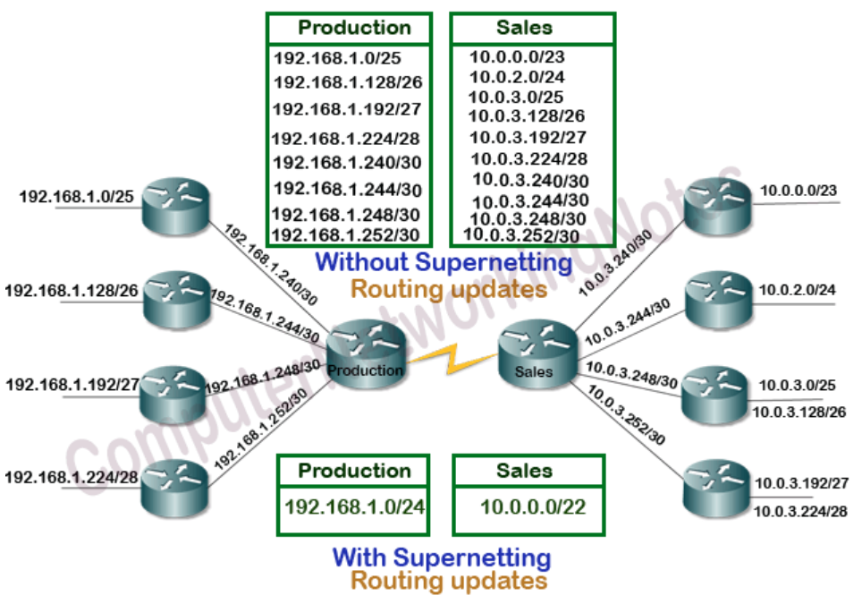
Route Summarization Example

Slide 14
Routers and Routing

Slide 15
Router Basics
A router is a layer-3 device (network layer)
Carries traffic from one network/subnet to another network/subnet
A router has one IP address and one MAC address on each network/subnet
Uses routing tables and routing protocols
Routing can be static (manual) or dynamic (automatic)

Slide 16
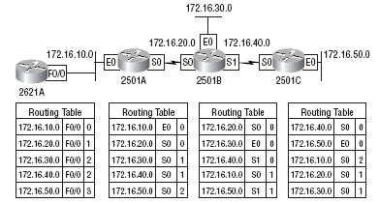
Routing Table

Slide 17
Dynamic Routing Protocols/Algorithms
Dynamic Routing Protocols
Interior Gateway Protocols (IGP)
Exterior Gateway Protocols (EGP)
Distance Vector Routing
Link State Routing
Path Vector Routing
RIP
IGRP/EGRP
OSPF
BGP

Slide 18
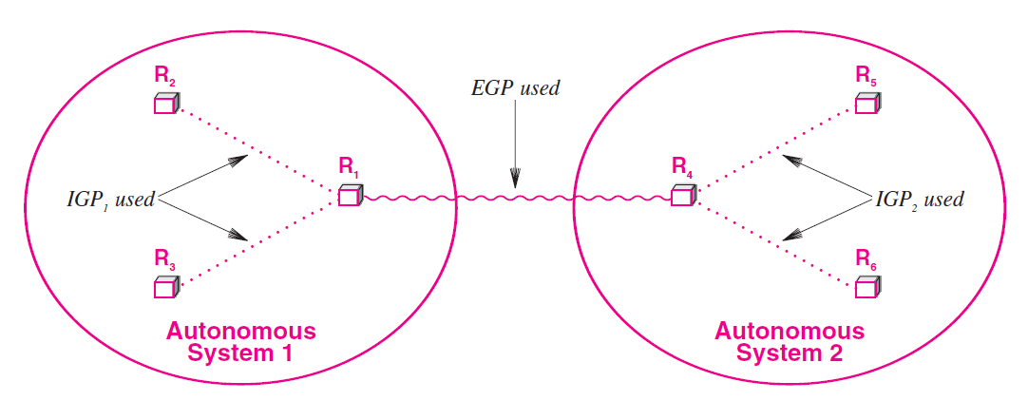
Interior and Exterior Gateway Protocols

Slide 19
Classes of Routing Protocols
Distance Vector Protocols (Example: RIP – Routing Information Protocol)
Use distance to measure the route cost
Link State Protocols (Example: OSPF – Open Shortest Path First)
Do not broadcast routing data to the whole network
Path Vector Protocols (Example: BGP – Border Gateway Protocol)
Work across interior networks, i.e. in an exterior network

Slide 20
Routing Information Protocol (RIP)
RIP routers use only routing tables to store information
RIP can store multiple routes to the same destination and uses as its metric a value called hop count
Hop count is the number of routers that are in the path to the destination network using that route
Broadcasts UDP data packets to exchange routing information
Cisco software sends routing information updates every 30 seconds, which is termed advertising
If a device does not receive an update from another device for 180 seconds or more, the receiving device marks the routes served by the non updating device as unusable
If there is still no update after 240 seconds, the device removes all routing table entries for the non updating device

Slide 21
Enhanced Interior Gateway Routing Protocol (EIGRP)
Interior Gateway Routing Protocol (IGRP) is an alternative to RIP
Now replaced by Enhanced IGRP (EIGRP)
Routers on the same network segment exchange "hello" messages to become neighbors and share information with each other
They use the received information and build network maps to find the shortest path
To make routers the neighbors of each other, we must assign them a common ID, called Autonomous System (AS) number – See next slide
Works only on Cisco routers

Slide 22
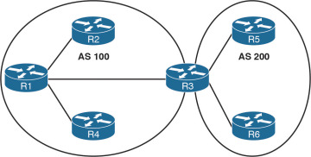
EIGRP and AS Number

Slide 23
Open Shortest Path First (OSPF)
Open Shortest Path First (OSPF) operates on non-Cisco routers also
Based on link-state routing
OSPF networks are divided into areas to improve scalability, reduce routing update traffic and simplify routing calculations: Area = Grouping of routers (See next slide)
Area 0 is called backbone area (main area) – it is mandatory and connects to all the other areas in the network using Area Border Routers (ABR)
Every router maintains a Link-State Database (LSDB) that contains information about the entire OSPF network's topology - This database is used to calculate the OSPF routing table for the router
RIP works fine in small networks, but not in large networks; OSPF works in both
When routers exchange information, they use special packets called Link-State Advertisement (LSA) – See slide after next
Frequency of exchange is once in every 1-2 hours

Slide 24
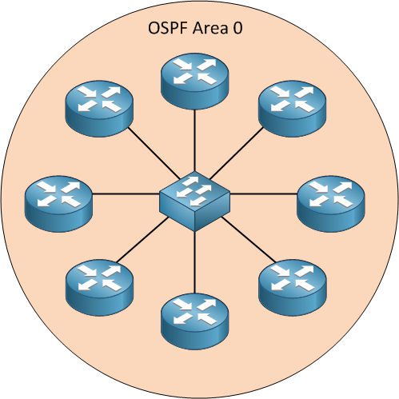
OSPF Area

Slide 25
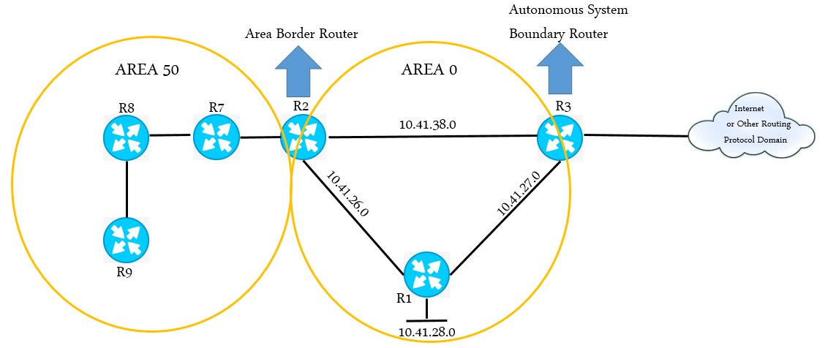
OSPF “Area” Concept
Open Shortest Path First (OSPF) operates on non-Cisco routers also
Based on link-state routing
OSPF networks are divided into areas to improve scalability, reduce routing update traffic and simplify routing calculations
Area = Grouping of routers
RIP works fine in small networks, but not in large networks
When routers exchange information, it is called as flooding
Frequency of exchange is once in every 1-2 hours

Slide 26
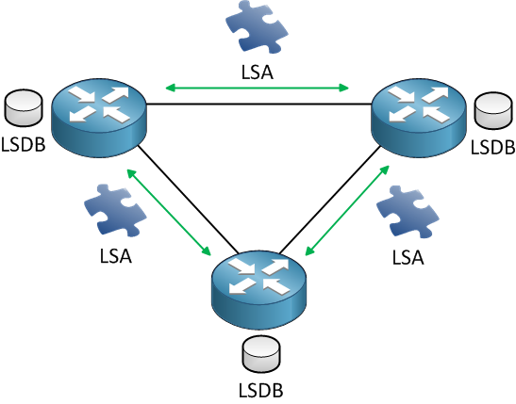
OSPF: LSDB and LSA

Slide 27
Protocol/Method | Technique | Example
Static routing | Manually assign routes | R1(config)#ip route 172.168.30.0 255.255.255.0 172.168.20.2 R1(config)#ip route 172.168.40.0 255.255.255.0 172.168.20.2
RIP (Dynamic routing) | Tell each router about its direct connections | R1(config)#router rip R1(config-router)#version 2 R1(config-router)#network 172.168.10.0 R1(config-router)#network 172.168.20.0
EIGRP (Dynamic routing) | Tell each router about its AS number | R1(config)#router eigrp 100 R1(config-router)#network 172.168.10.0 R1(config-router)#network 172.168.20.0
OSPF (Dynamic routing) | Tell each router about its area | R1(config)#router ospf 1 R1(config-router)#network 172.168.10.0 0.0.0.255 area 0 R1(config-router)#network 172.168.20.0 0.0.0.255 area 0
1 is the AS number

Slide 28
Network Address Translation (NAT)

Slide 29
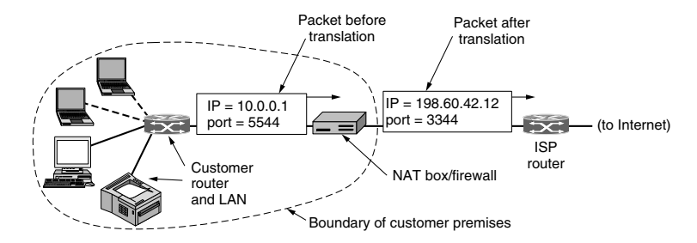
Network Address Translation (NAT) Concept

Slide 30
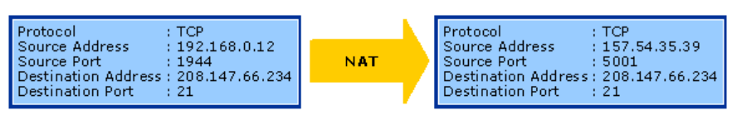
NAT Mapping Example

Slide 31
InfiniBand Network

Slide 32
InfiniBand Network
InfiniBand is an open standard network interconnection technology with high bandwidth, low delay and high reliability
This technology is defined by IBTA (InfiniBand Trade Alliance)
This technology is widely used in HPC
Supports basic Single Data Rate (SDR) of 2.5 Gbps
Usually, four cables are used together, to geta speed of 10 Gbps
Another improvement called as Quad Data Rate (QAD) signaling takes this rate to 40 Gbps
Significant advantages over Ethernet and optical fiber

Slide 33
InfiniBand Basics
Traditionally, I/O was handled by the shared PCI bus (32 or 44 bit transfer)
In InfiniBand, the I/O is handled not by processors, but by interconnect architecture
This means that the I/O does not go to the kernel area of the operating system, but directly comes in to or goes out from the user area
Makes it very fast
Packets are of 4 KB

